Slide 1
205 Jan 17, Class 6
Chapter 5, Statistics
Descriptive statistics
Inferential statistics
Data visualization
Practical approaches
Calculating statistics
Reporting statistics
Data visualization

Slide 2
Descriptive statistics for Exp 1
Working with spreadsheets
Selecting cells, selecting ranges, entering formulas
Mean
=average()
Standard deviation
=stdev.s()
Standard error
SD/sqrt(n)
Counting n
Building a formula

Slide 3
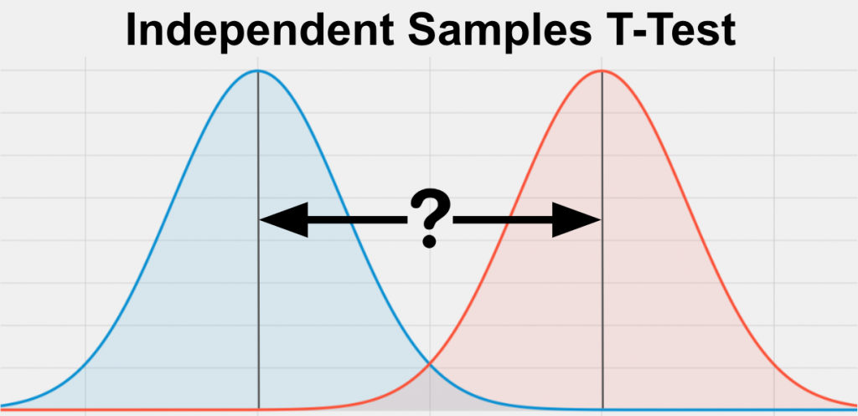
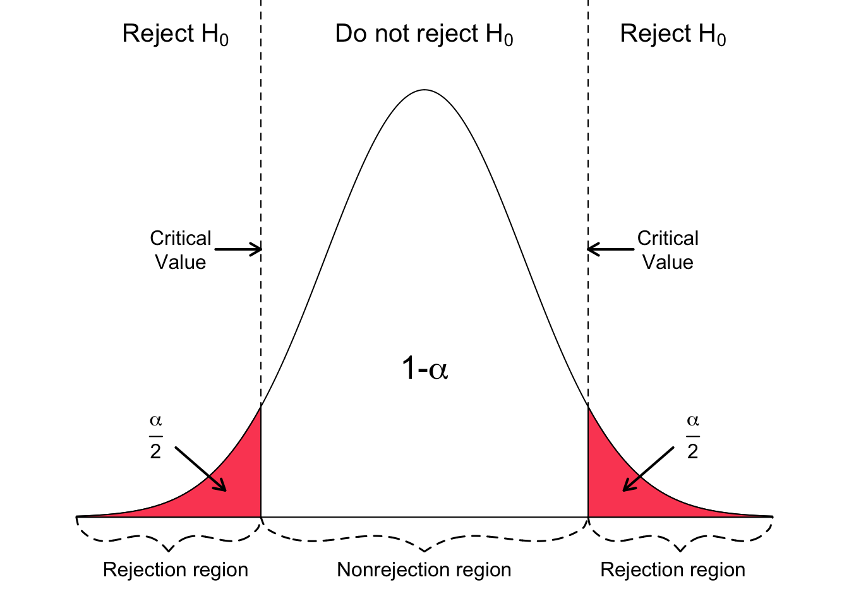
Theory: t-test
t = mean difference / variance
Data distributions for two conditions

Slide 4
Practical Inferential Statistics
Running a t-test on data
Two independent samples t-test
Assuming equal variances
Applying a 2-tailed criterion
Alpha = .05
Software
R & RStudio – free, highly accurate
SPSS – expensive, highly accurate
MS Excel – available, slightly inaccurate

Slide 5
Using R
Installing R
Installing RStudio
Programming environment
Running commands
Multiple panes of information
Using the correctly formatted version of the data
The ‘.csv’ file is set up slightly differently
Following the given recipe
Once everything is configured, just Run->

Slide 6
Reading statistical output
All statistical programs produce a lot of information
Communicating the results
Parsing the output
Selecting the correct values
Reporting in APA format
t(df) = X.XX, p < .YYY
t(df) = X.XX, p = .yyy

Slide 7
Writing your results section
Includes both descriptive and inferential statistics
Give the performance of both groups
State the direction of the effect
Support with inferential statistics
Very compact, but high-risk
Triple check your numbers

Slide 8
Fill in the reporting template
“On the recognition test, the Condition-A participants exhibited performance of XXX [units] (SD XX; SE XX) while the Condition-B participants exhibited performance of XXX [units] (SD XX; SE XX). The Condition-A group performed significantly better than the Condition-B group, t(xx)=ZZZ, p<YYY.”
Replace
Condition-A, Condition-B
Optionally: ‘exhibited performance’
Include ‘units’
Add all the numbers, descriptive and inferential

Slide 9
Making a figure
Back to Excel
Getting a basic graph is straightforward
Necessary edits
Label the y-axis
Add SE bars
Recommended edits
Remove title, gridlines
Optional edits
Colors, layout, design

Slide 10
For Fri Jan 19
Chapter 6, Writing in APA format
Chapter 7, Within-participants design
Start drafting your first writeup
Write your results section
Add your figure
Add your figure caption

